Slide 1
Power BI Dashboard – Global Sales and Profit Analysis
Amrutha Varshini G
26 June,2025

Slide 2
Objective
To design an interactive dashboard using Power BI
To analyze global sales and profit performance
To identify areas where the company is losing money
To support data-driven business decisions

Slide 3
Key Insights from the Dashboard
Total Profit: INR X,XX,XXX (from your card visual)
Losses observed in regions like South America and Central Africa
Technology category had low or negative profit, despite high sales
Pie chart shows major profit comes from Office Supplies
Line chart indicates profit dip in Q2, recovery in Q4

Slide 4
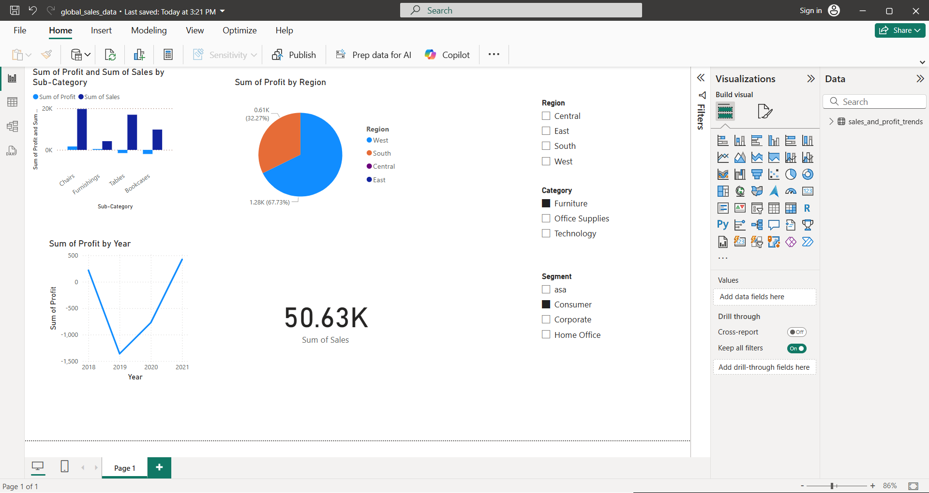
Power BI Dashboard Preview

Slide 5
Conclusion
Created an interactive dashboard for profit-loss analysis
Delivered insights using Cards, Maps, Pie & Line Charts
Enabled slicing by Category and Region for real-time filtering
Helped highlight key loss areas and improvement zones for stakeholders

